Slide 1
All about ladybirds

Slide 2
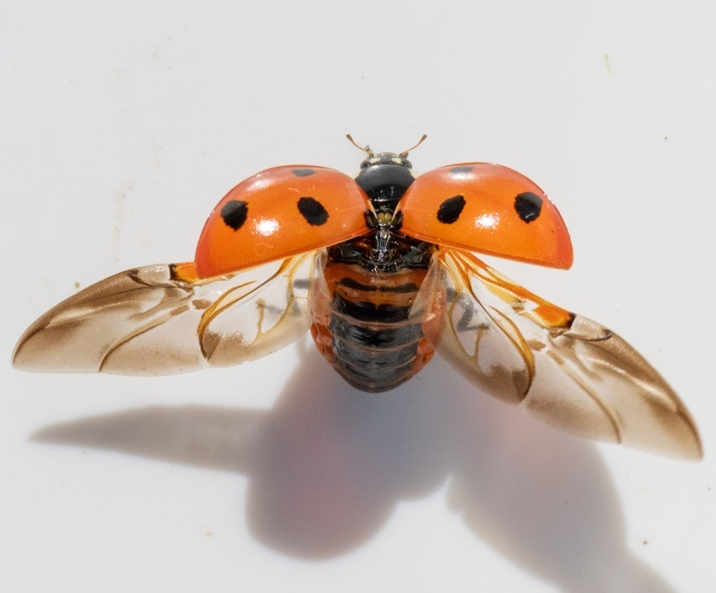
What is a ladybird?
All about ladybirds
A ladybird is a type of beetle.
Beetles’ front wings have become hard shells called elytra (eh-LIE-tra).
Most beetles have back wings that fold out for flying.

Slide 3
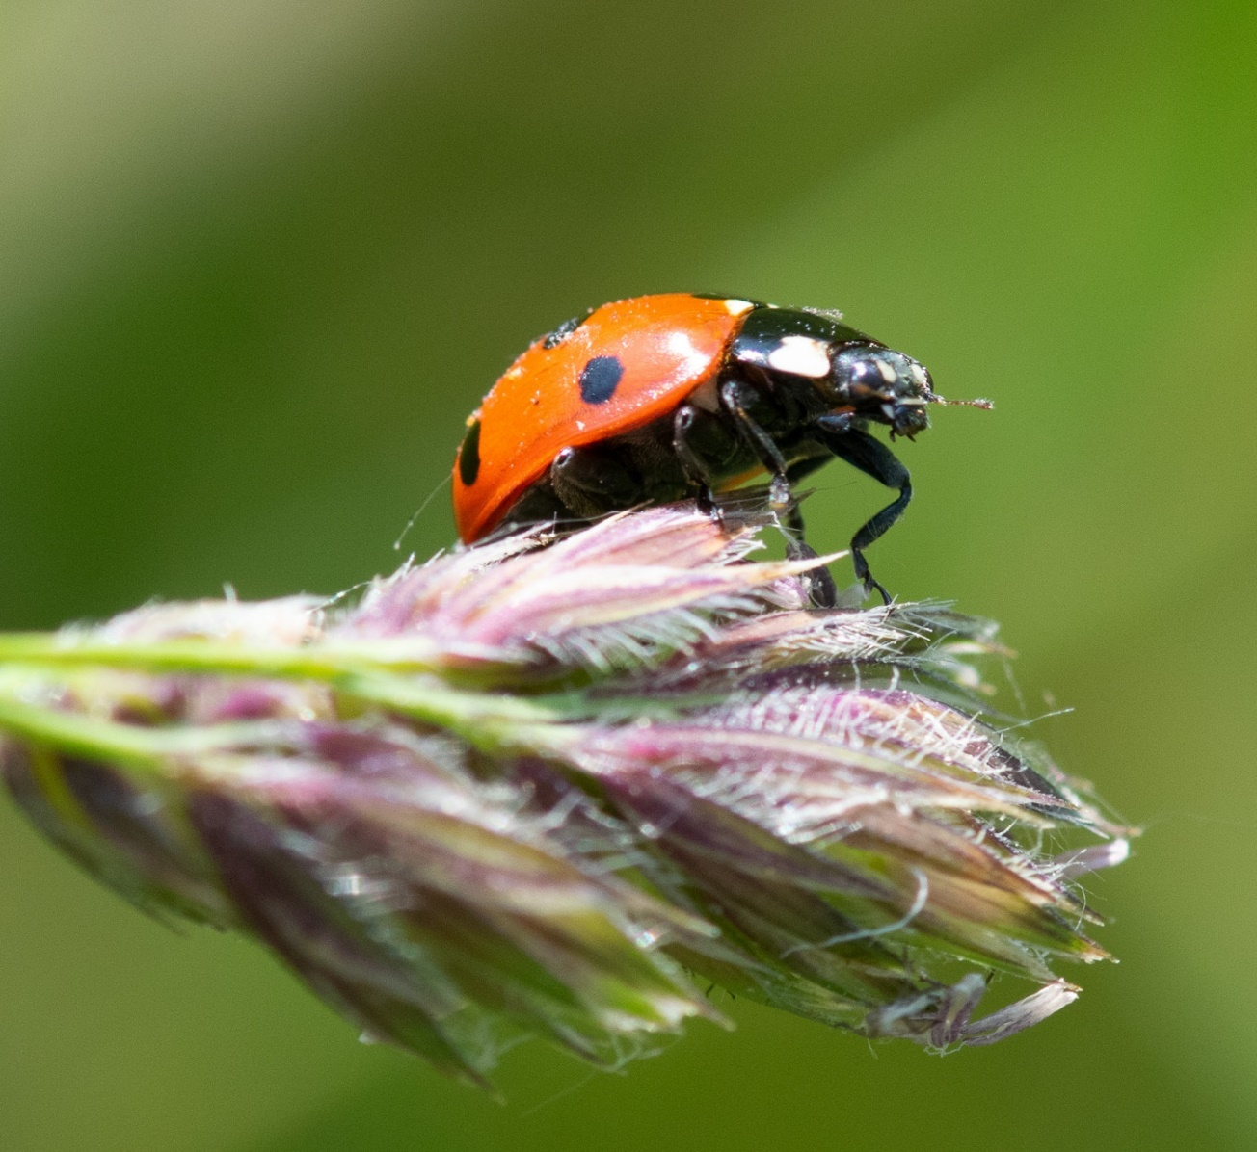
Ladybirds in the UK
All about ladybirds
There are around 46 types of ladybird which can be found in the UK
Only a few of them are red with black spots.

Slide 4
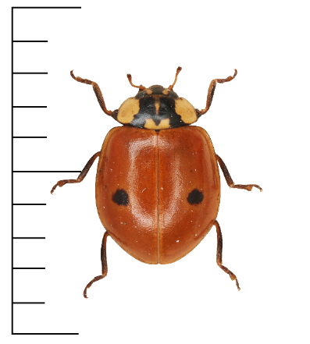
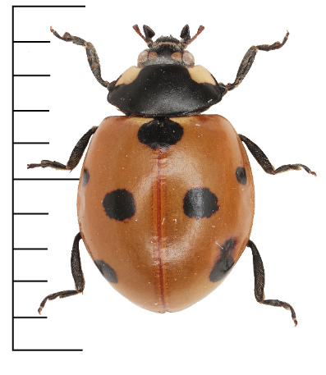
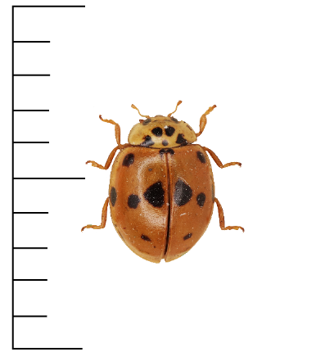
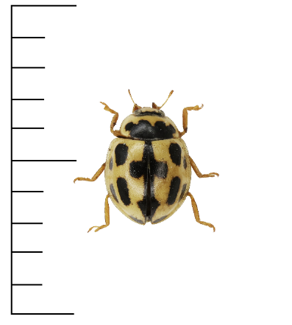
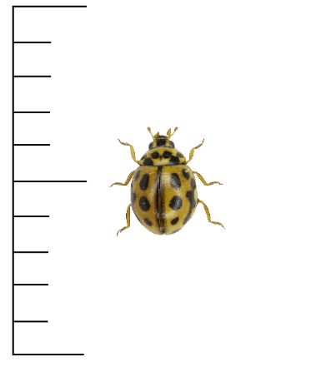
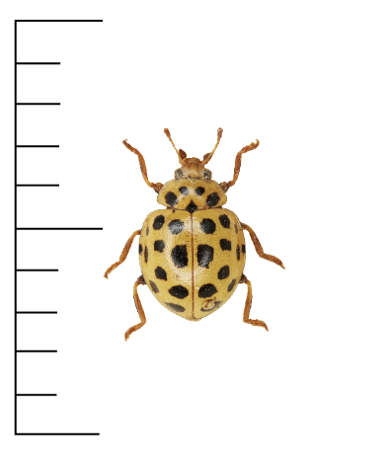
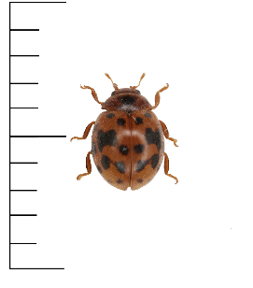
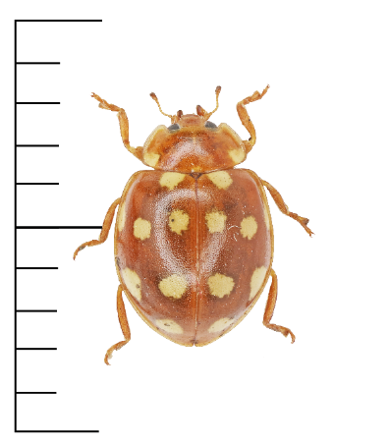
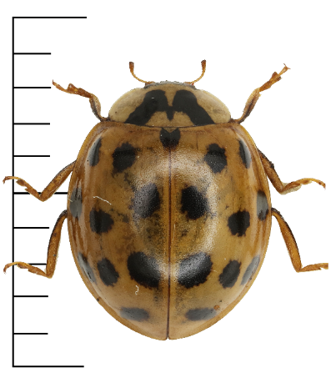
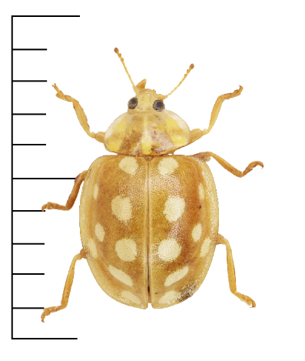
Common UK ladybirds
All about ladybirds
2-spot
7-spot
10-spot
14-spot
16-spot
22-spot
24-spot
Cream-spot
Harlequin
Orange

Slide 5
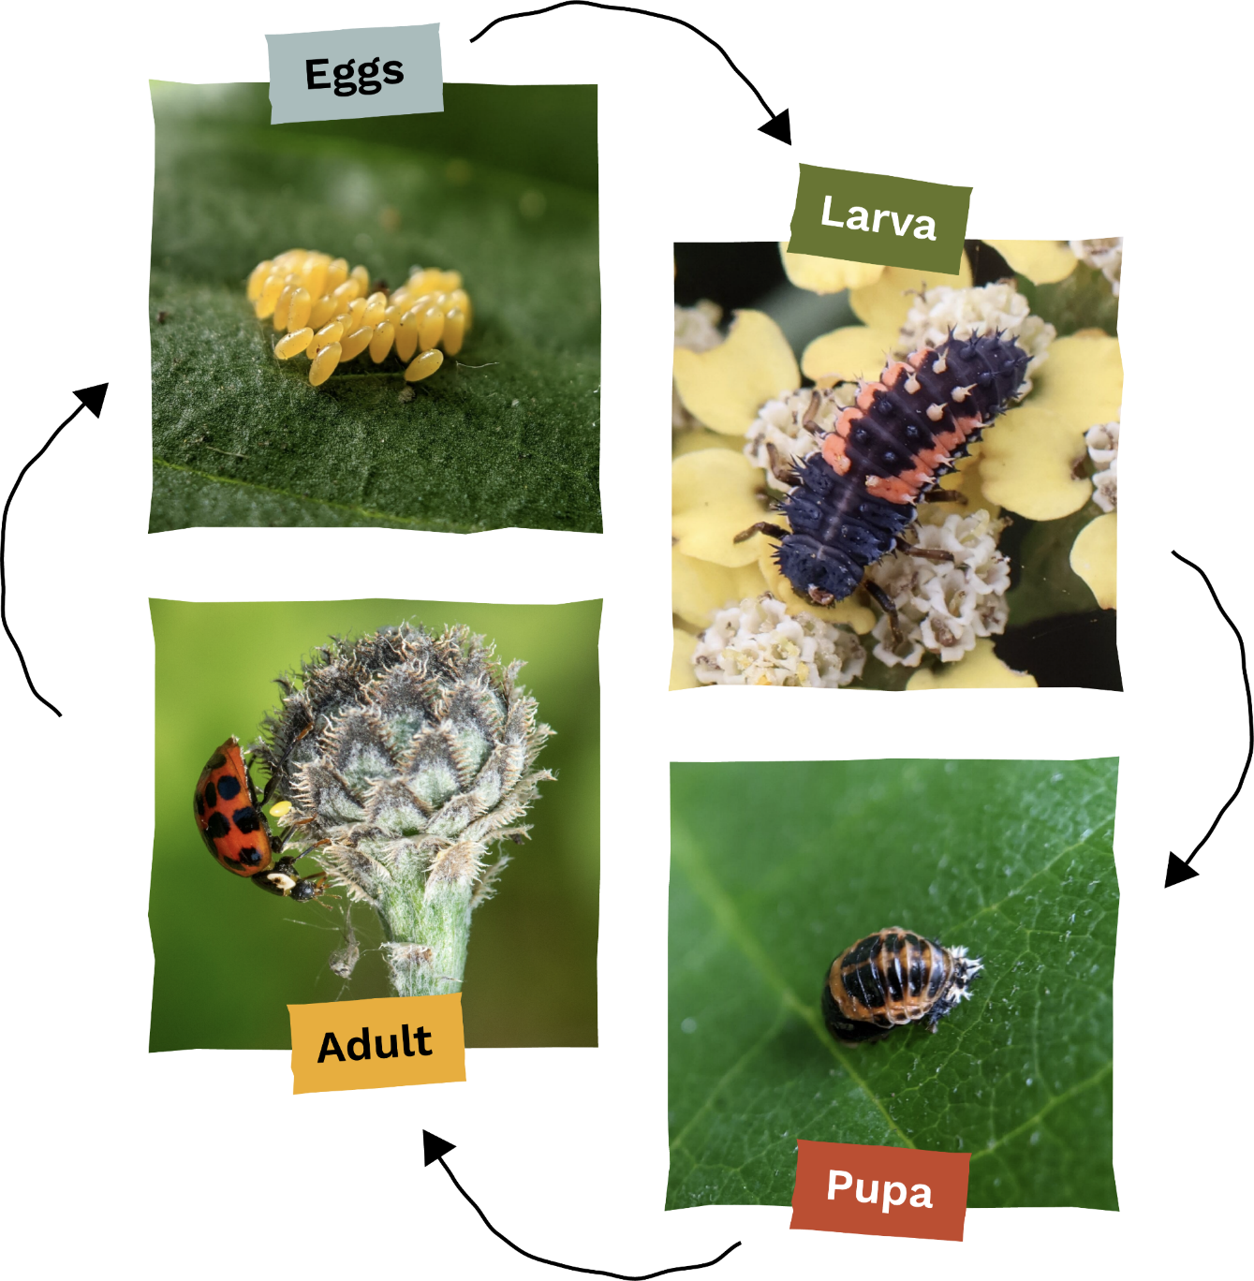
Ladybird lifecycle
All about ladybirds
Ladybirds go through complete metamorphosis.
This is the same type of lifecycle as butterflies and moths.
Egg
Larva
Pupa
Adult

Slide 6
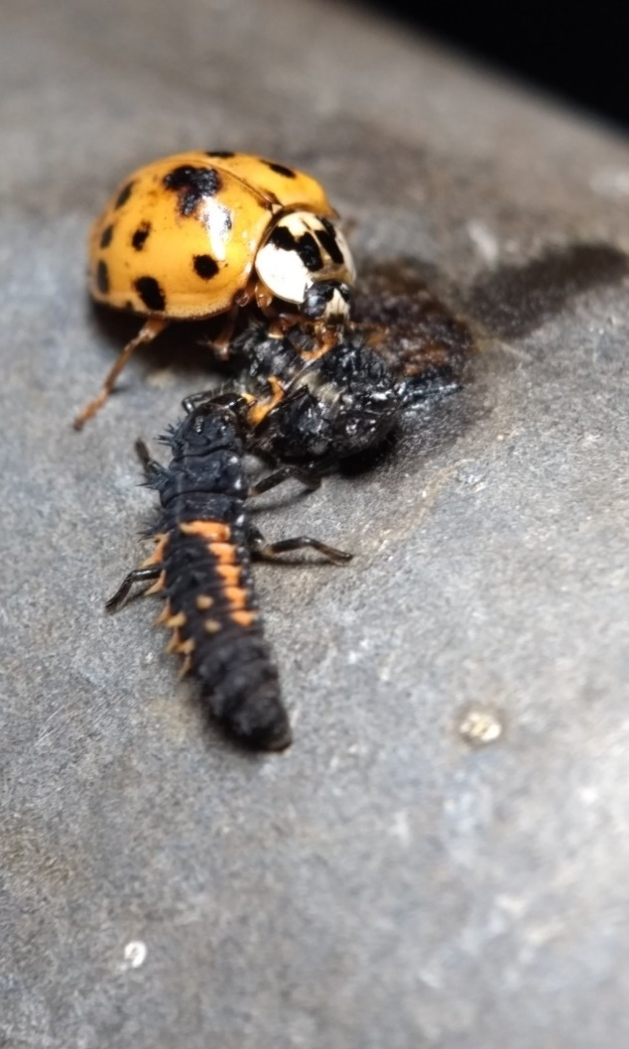
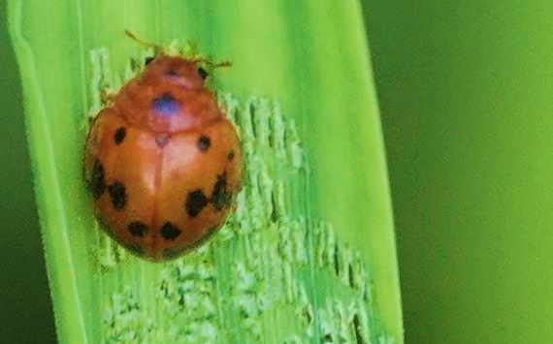
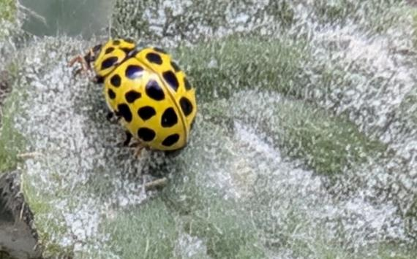
What do ladybirds eat?
All about ladybirds
Most ladybirds eat other small invertebrates such as aphids or caterpillars. Some will eat other ladybirds!
Some ladybirds eat plants or mould (similar to the stuff that grows on old bread).
24-spot ladybird eating a leaf.
Harlequin ladybird adult and larva eating another harlequin ladybird larva!
22-spot ladybird eating powdery mildew, a type of fungus.

Slide 7
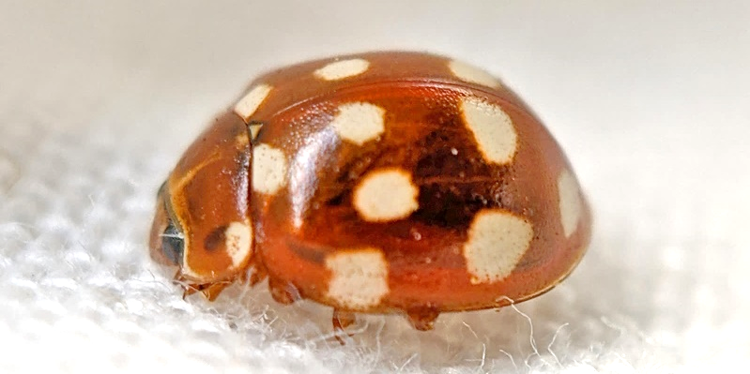
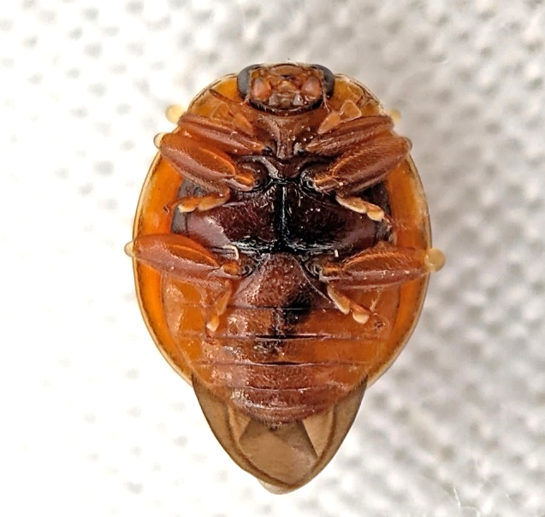
Staying safe
All about ladybirds
When scared or resting, ladybirds tuck in their legs and antennae.
To escape predators, some ladybirds let go of the leaf or branch they are on, dropping down to the ground.
Bright colours warn predators that ladybirds are poisonous.

Slide 8
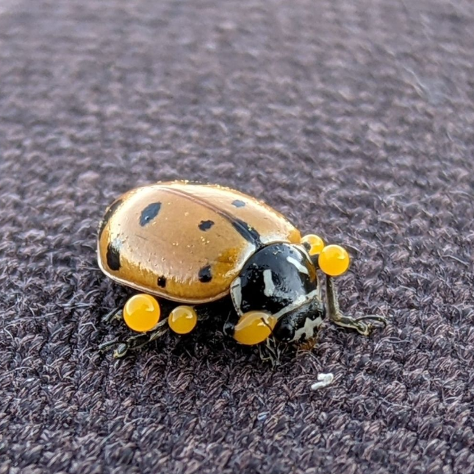
Staying safe
All about ladybirds
Most ladybirds make poisons which taste bad to predators.
Some ladybirds can squeeze out smelly, bad-tasting, or poisonous liquid from their joints.

Slide 9
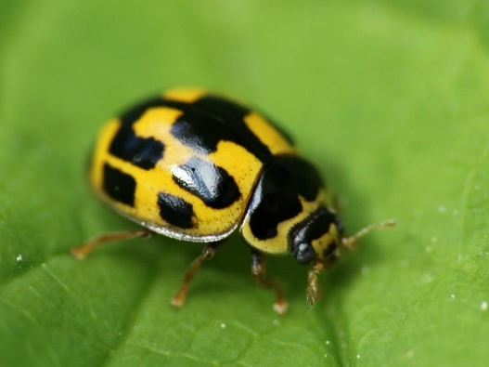
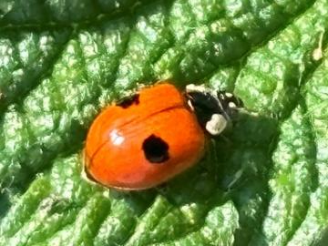
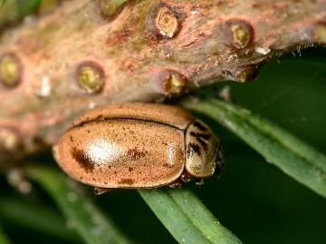
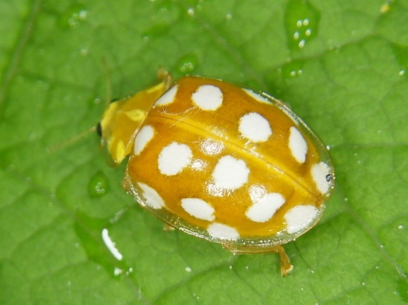
Camouflage versus Poison
All about ladybirds
Usually, ladybird species which are less camouflaged to birds are more poisonous.
Less
poisonous
More
poisonous
Larch ladybird
14-spot ladybird
2-spot ladybird
Orange ladybird
See the research here:
María Arenas, L., Walter, D. & Stevens, M. Signal honesty and predation risk among a closely related group of aposematic species. Sci Rep 5, 11021 (2015). https://doi.org/10.1038/srep11021

Slide 10

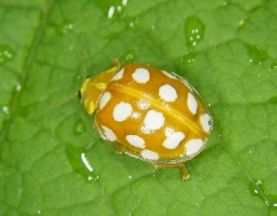
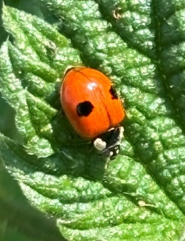
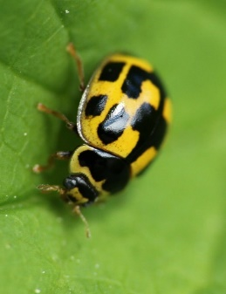

Camouflage versus Poison
All about ladybirds
More
poisonous
Toxicity
Less
poisonous
More camouflaged
Less camouflaged
Contrast with background
See the research here:
María Arenas, L., Walter, D. & Stevens, M. Signal honesty and predation risk among a closely related group of aposematic species. Sci Rep 5, 11021 (2015). https://doi.org/10.1038/srep11021
Notes:
Researchers found that the orange ladybird did not have a lot of contrast against sycamore leaves but was the most toxic species in their study.
They noted that other factors are involved in a beetle’s chance to be eaten by a predator. For example, orange ladybirds were often found underneath leaves, and birds might be more likely to be looking for food from above.
Many beetles also protect themselves by letting go of leaves or branches when disturbed, dropping to the ground.

Slide 11
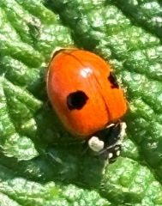
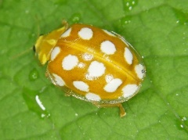
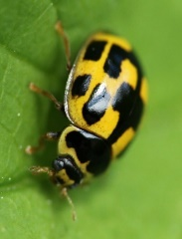
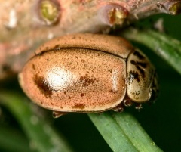
Camouflage versus Poison
More
poisonous
In one study scientists found the orange ladybird was the most poisonous of the ladybirds they looked at, even though it didn’t contrast as much with leaves.
Scientists don’t know if there is a reason for this.
Ladybirds don’t just protect themselves with camouflage and poison. They can also hide under leaves and drop to the ground.
Less
poisonous
More camouflaged
Less camouflaged
See the research here:
María Arenas, L., Walter, D. & Stevens, M. Signal honesty and predation risk among a closely related group of aposematic species. Sci Rep 5, 11021 (2015). https://doi.org/10.1038/srep11021

Slide 12
We hope you found this resource useful!
Send your feedback to school-bookings@nhm.ac.uk
This resource was produced with support from Evolution Education Trust.

